Slide 1






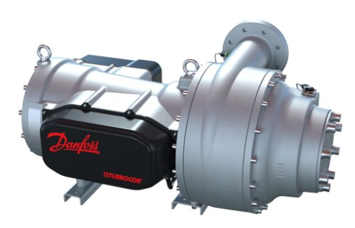
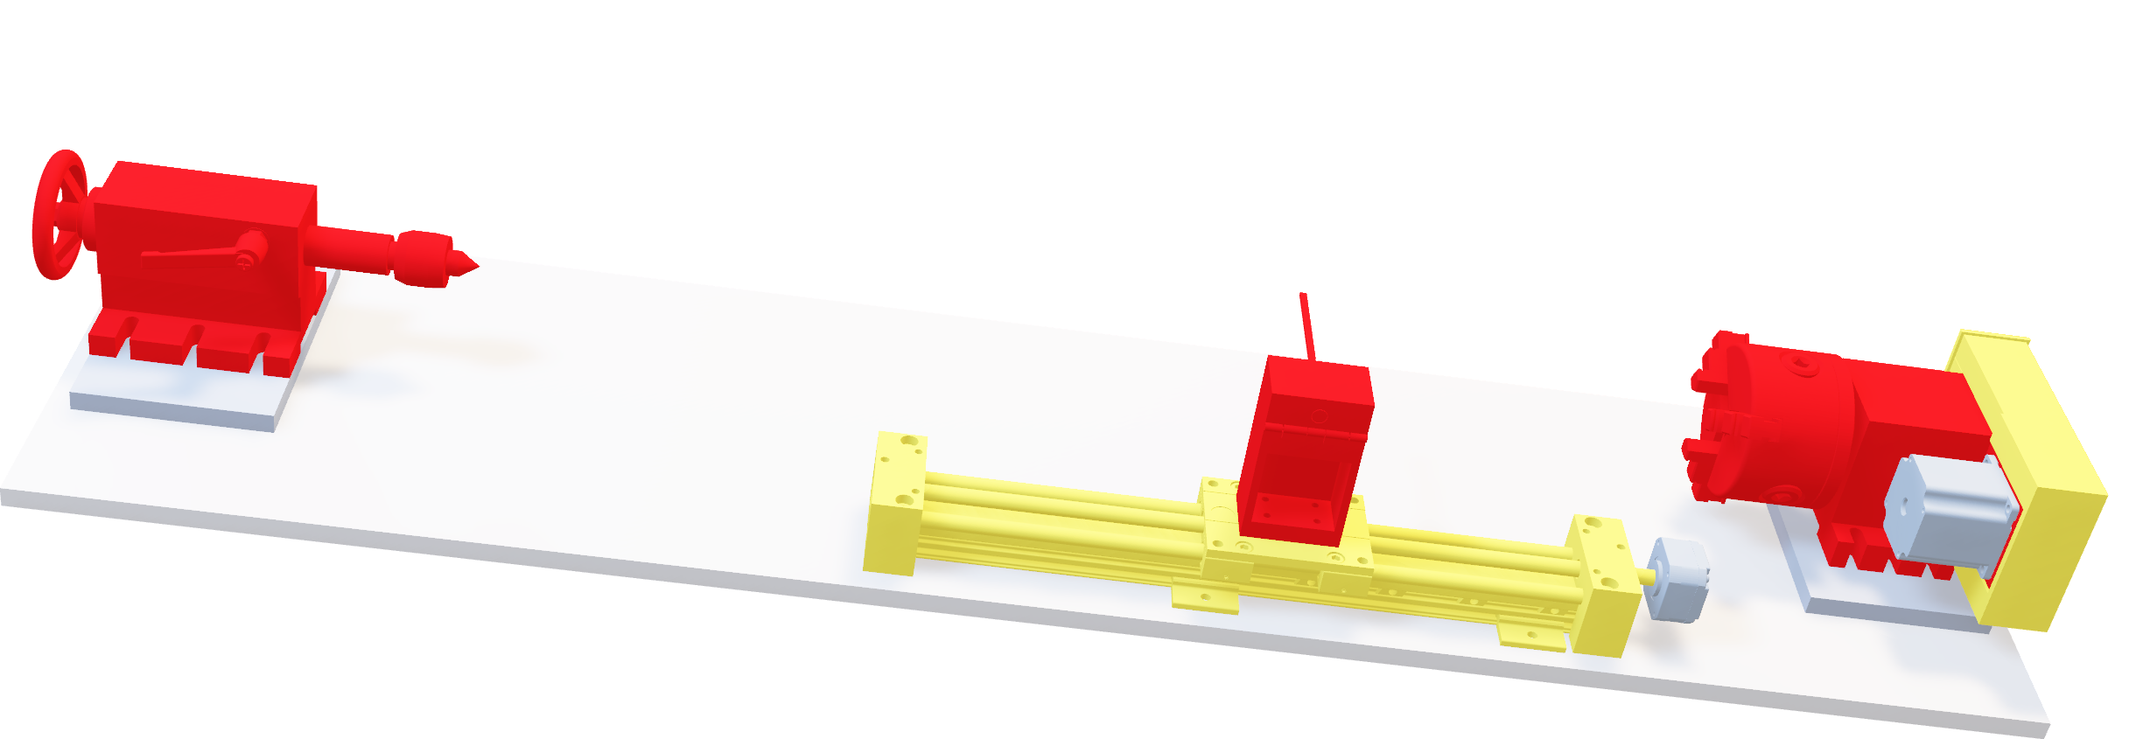
Automated Flux Reader (AFR)
Team 513 | Andrew Atallah | Sean Hemstreet | Joshua Huls | Liora Louis
Objective:
Inspiration:
Data Collection:
To create a system to capture and map the magnetic flux of compressor shafts.
Danfoss uses magnetic blade shafts to reduce friction in their compressors. Formation of inconsistencies in the magnetized section of the shafts jeopardizes the flux. The current method used to validate the flux of these shafts is unreliable and labor intensive.
An Arduino controls the linear guide rail and chuck while a C++ application controls the fluxmeter and the measurement process. Signals are then sent between the two to ensure in-sync measurements.
Key Goals:
Tailstock & Live Center
Automation
Motorized Chuck
Accuracy
Tools:
Consistency
Motorized Chuck
Adaptability
Tailstock & Live Center
Linear Guide Rail
Linear Guide Rail
C++ Application & Arduino
VTX Compressor:
Fluxmeter
For quality purposes the magnetic region of these shafts needs to be measured and mapped. The Automated Flux Reader (AFR) will be used to detect flux deviation within these shafts. The measurements will be spaced out 5 mm apart in the both the axial and circumferential direction.
Measurements:
AFR will obtain the magnetic flux density at ~2,600 locations on the test section.

